Slide 1
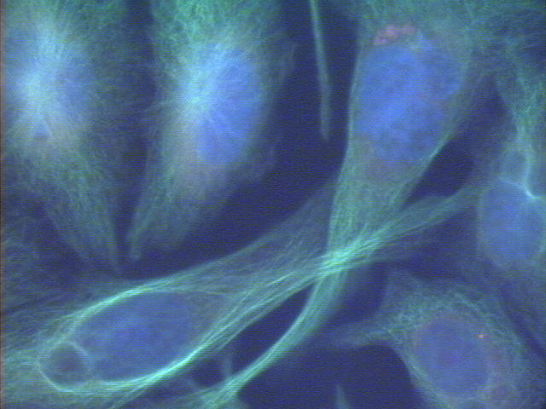
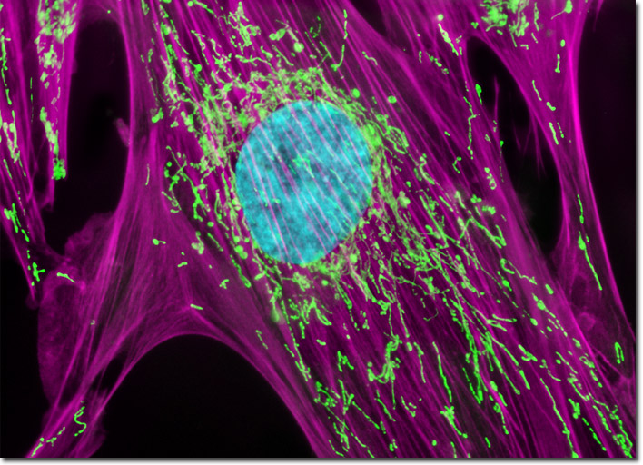
Cell Organelles
Notes:
Use this presentation in conjunction with the Cell Organelle note-taking worksheet. Run through the entire presentation before using it in class so that you know what’s coming next! It helps to print the outline and notes to have with you while presenting so that there are no surprises.

Slide 2
Cell Organelles
Organelle= “little organ”
Found only inside eukaryotic cells
All the stuff in between the organelles is cytosol
Everything in a cell except the nucleus is cytoplasm
Notes:
You may or may not wish to distinguish between cytosol and cytoplasm. The correct use of each term is shown here. Most high school textbooks, however, use the word “cytoplasm” to mean “cytosol.”

Slide 3
Cell Membrane
Boundary of the cell
Made of a phospholipid bilayer
Notes:
Emphasize word parts here:
phospho= phosphate head; lipid= fatty acid tail
bi= 2

Slide 4
Nucleus
Control center of the cell
Contains DNA
Surrounded by a double membrane
Usually the easiest organelle to see under a microscope
Usually one per cell
Notes:
Cells with more than one nucleus include muscle cells and liver cells, largely because of the massive volume of cytoplasm and number of organelles that need controlling.

Slide 5
Cytoskeleton
Acts as skeleton and muscle
Provides shape and structure
Helps move organelles around the cell
Made of three types of filaments
Notes:
Actin, also found in muscle cells, mainly help maintain cell shape in their cytoskeletal role. Microtubules mostly move organelles around the cell. Intermediate filaments also provide structural support.

Slide 6
Endoplasmic Reticulum
A.k.a. “ER”
Connected to nuclear membrane
Highway of the cell
Rough ER: studded with ribosomes; it makes proteins
Smooth ER: no ribosomes; it makes lipids
Notes:
It’s not necessary that the students can read the labels here; just point out the black dots are ribosomes.

Slide 7
Ribosome
Site of protein synthesis
Found attached to rough ER or floating free in cytosol
Produced in a part of the nucleus called the nucleolus
That looks familiar…what is a polypeptide?
Notes:
A polypeptide is a chain of amino acids. In this diagram, you can see the ribosome is making a polypeptide, also known as a protein.

Slide 8
Golgi Apparatus
Looks like a stack of plates
Stores, modifies and packages proteins
Molecules transported to and from the Golgi by means of vesicles
Notes:
AKA Golgi Complex. It is not necessary that the students read the labels, this diagram gives them a general idea of the Golgi’s shape.

Slide 9
Lysosomes
Garbage disposal of the cell
Contain digestive enzymes that break down wastes
Which organelles do lysosomes work with?
Notes:
Students should recognize the shapes of the Golgi and ER even if they cannot read the captions.

Slide 10
Mitochondria
“Powerhouse of the cell”
Cellular respiration occurs here to release energy for the cell to use
Bound by a double membrane
Has its own strand of DNA
Notes:
Explain that this diagram shows the mitochondria cut open to reveal the internal membranes.

Slide 11
Chloroplast
Found only in plant cells
Contains the green pigment chlorophyll
Site of food (glucose) production
Bound by a double membrane
Notes:
Chloroplasts absorb light, which is the catalyst for photosynthesis.

Slide 12
Cell Wall
Found in plant and bacterial cells
Rigid, protective barrier
Located outside of the cell membrane
Made of cellulose (fiber)
Notes:
This is an actual microscopic image. Explain that the colors are added digitally to enhance the different parts.

Slide 13
Vacuoles
Large central vacuole usually in plant cells
Many smaller vacuoles in animal cells
Storage container for water, food, enzymes, wastes, pigments, etc.
What type of microscope may have been used to take this picture?
Notes:
The image is 2D, so it must have been a light microscope or TEM. If the cell is very tiny, then a TEM was used. Otherwise, a strong light microscope could have captured this image.

Slide 14
Centriole
Aids in cell division
Usually found only in animal cells
Made of microtubules
Notes:
Microtubules are also part of the cytoskeleton.

Slide 15
Quick Review
Which organelle is the control center of the cell?
Nucleus
Which organelle holds the cell together?
Cell membrane
Which organelles are not found in animal cells?
Cell wall, central vacuole, chloroplasts
Which organelle helps plant cells make food?
Chloroplasts
What does E.R. stand for?
Endoplasmic reticulum
Notes:
You may choose to delete the answers from the PowerPoint or change the animation so that they come in after all 5 questions are asked in case you want to quiz students individually at the end.

Slide 16
So what does this mean for our ADI?
The unknown slide was a Euglena.
Euglena belong to the kingdom Protista, they are neither animal nor plant, they are also neither prokaryotic or eukaryotic.

Slide 17
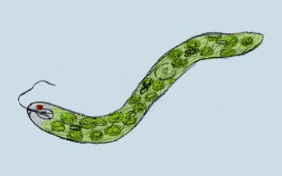
Why isn’t it an animal cell?
It contains chloroplasts.
Chloroplasts are characteristic of plant cells and indicate that the organism can make its own food in the form of glucose

Slide 18
Why isn’t it a plant cell?
The unknown sample does not have a rigid cell wall or the presence of very large vacuoles for holding water.
Cell walls are a defining characteristic of plant cells.

